Slide 1
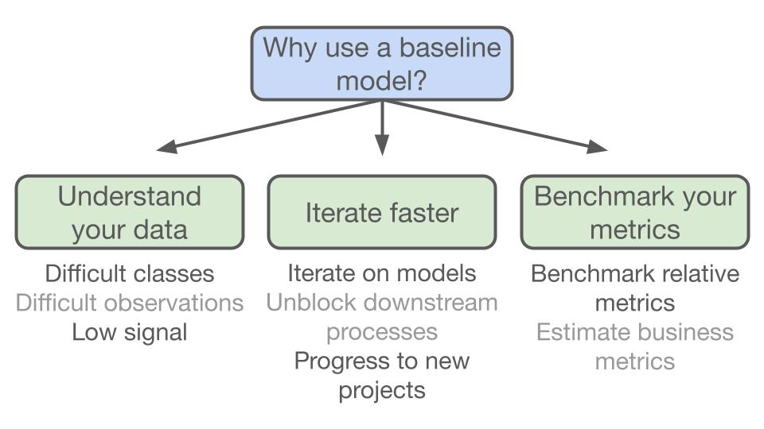
Baseline Classifiers
5
- Dr. Sifat Momen (SfM1)

Slide 2
Learning goals
After this presentation, you should be able to
Understand the need for baseline models
Understand and apply ZeroR and OneR classifiers

Slide 3
Jupyter Notebook
Please note that there is an associated Jupyter notebook with this presentation
Please use both in parallel for optimal understanding

Slide 4
Baseline Models
A baseline model is essentially a simple model that acts as a reference in a machine learning project.
Its main function is to contextualize the results of trained models.
Baseline models usually lack complexity and may have little or no predictive power.
Regardless, their inclusion is a necessity for many reasons.

Slide 5
Baseline Models

Slide 6
ZeroR classifier
ZeroR stands for Zero Rule
Simplest classification method that relies on the target and ignores all predictors.
ZeroR classifier simply predicts the majority category.
Although there is no predictability power in ZeroR, it is useful in determining a baseline performance as a benchmark for other classification methods.

Slide 7
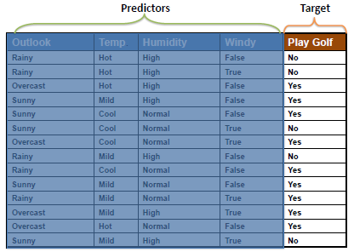
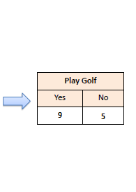
ZeroR Classifier

Slide 8
Implementation of ZeroR Classifier using Sklearn
from sklearn.dummy import DummyClassifier
dummy = DummyClassifier(strategy = "most_frequent")
X = df.drop(columns = 'Play Golf')
y = df['Play Golf']
dummy.fit(X, y)
dummy.predict(testX)
array(['Yes', 'Yes', 'Yes'], dtype='<U3')

Slide 9
Train and Test Accuracy
from sklearn.metrics import accuracy_score
print('Train Accuracy', accuracy_score(df['Play Golf'], dummy.predict(X)))
print('Test Accuracy', accuracy_score(testSet['Play Golf'],
dummy.predict(testX)))
Train Accuracy 0.6428571428571429
Test Accuracy 0.3333333333333333

Slide 10
Custom ZeroR Classifier
from sklearn.base import ClassifierMixin
from sklearn.base import BaseEstimator
class ZeroR(BaseEstimator, ClassifierMixin):
def __init__(self):
pass
def fit(self, X= None, y = None):
self.y_hat = y.value_counts().idxmax()
return self
def predict(self, X=None):
return np.full((1, X.shape[0]), self.y_hat)

Slide 11
OneR Classifier
OneR stands for “One Rule”
A simple, yet accurate, classification algorithm that generates one rule for each predictor in the data, then selects the rule with the smallest total error as its “one rule”.
OneR Algorithm:
For each predictor, For each value of that predictor, make a rule as follows; Count how often each value of target (class) appears Find the most frequent class Make the rule assign that class to this value of the predictor Calculate the total error of the rules of each predictor Choose the predictor with the smallest total error.

Slide 12
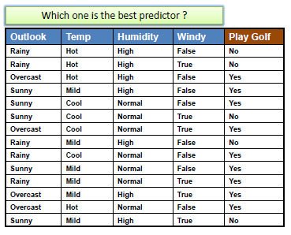
OneR classifier

Slide 13
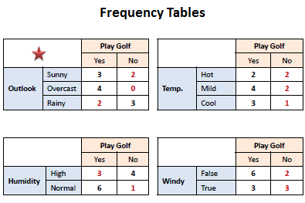
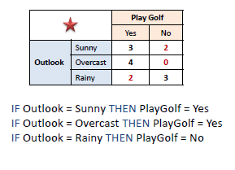
OneR Classifier
Find the Train Accuracy?

